Slide 1

Hello World Week
June 2024
Week of June 24th
Notes:
Talking Points:
Speaker Introduction (role)
Context setting: Today, we are here to learn more about our latest offering Azure IoT Operations, now in Public Preview. Azure IoT Operations expands our in-market Azure IoT portfolio with a modular set of Arc-enabled services that help organizations onboard assets, capture insights, and take actions to scale the transformation of their physical operations.

Slide 2






Get Started with Hello World!
Be part of the journey and get started today: https://github.com/flecoqui/HelloWorld
Explore languages, source code, tools, cloud, …
Azure
Notes:
Talking Points:
Azure IoT Operations is in Public Preview right now, we’d love for you to get started with it today. Checkout the link on the slide as a next step in your exploration.

Slide 3
Agenda
Topic/Section | Section Details
Prepare your environment | Visual Studio Code Git Client Create Github and Azure Accounts
C language | Install Compiler Build and run Hello World C program
Python | Install Python Build and run Hello World Python program
C# language | Install dotnet Build and run Hello World dotnet program
HTML/Javascript | Install HTML/Javascript Build and run your Web application
Notes:
Modify the Outline/agenda as needed

Slide 4



Prepare your environment Install Visual Studio Code
Install Visual Studio Code for Windows
https://code.visualstudio.com/Download
Install Visual Studio Code for Linux
https://code.visualstudio.com/Download
Install Visual Studio Code for Mac
https://code.visualstudio.com/Download
Notes:
Talking Points:
Azure IoT plays a key role in customers digital transformation journey.
We are expanding our IoT Portfolio to support customers evolving needs.
Our existing product portfolio has always been about more than just technology; they are about enabling customer’s possibilities. We're not just connecting devices; we're reimagining how products can redefine user experiences and expand their capabilities. In a world where every second counts, our solutions help customers gain better control and oversight over vast device landscapes, no matter their scale. And it's not just about creating new hardware; it's about crafting gateways for end-users to unlock untapped potential.
But innovation is an ongoing journey that evolves with changing landscape and our customers needs. More and more, we are seeing customers leveraging IoT to not just reimagine their products, but also to transform their physical operations.
For example, an OEM can use IoT data to improve their products or create new business models. As they gain insights from their connected products, they can leverage this data to optimize their physical operations and improve their overall performance. This might involve adding sensors to manufactured goods to offer them as a service and gain deeper insights into how they perform in production.
This is why we’re adding Azure IoT Operations to our IoT portfolio.

Slide 5

Prepare your environment Install Git Client
Install Git Client for Windows
https://git-scm.com/download/win
Install Git Client for Linux
https://git-scm.com/download/linux
Install Git Client for Mac
https://git-scm.com/download/mac
Notes:
Talking Points:
Azure IoT plays a key role in customers digital transformation journey.
We are expanding our IoT Portfolio to support customers evolving needs.
Our existing product portfolio has always been about more than just technology; they are about enabling customer’s possibilities. We're not just connecting devices; we're reimagining how products can redefine user experiences and expand their capabilities. In a world where every second counts, our solutions help customers gain better control and oversight over vast device landscapes, no matter their scale. And it's not just about creating new hardware; it's about crafting gateways for end-users to unlock untapped potential.
But innovation is an ongoing journey that evolves with changing landscape and our customers needs. More and more, we are seeing customers leveraging IoT to not just reimagine their products, but also to transform their physical operations.
For example, an OEM can use IoT data to improve their products or create new business models. As they gain insights from their connected products, they can leverage this data to optimize their physical operations and improve their overall performance. This might involve adding sensors to manufactured goods to offer them as a service and gain deeper insights into how they perform in production.
This is why we’re adding Azure IoT Operations to our IoT portfolio.

Slide 6
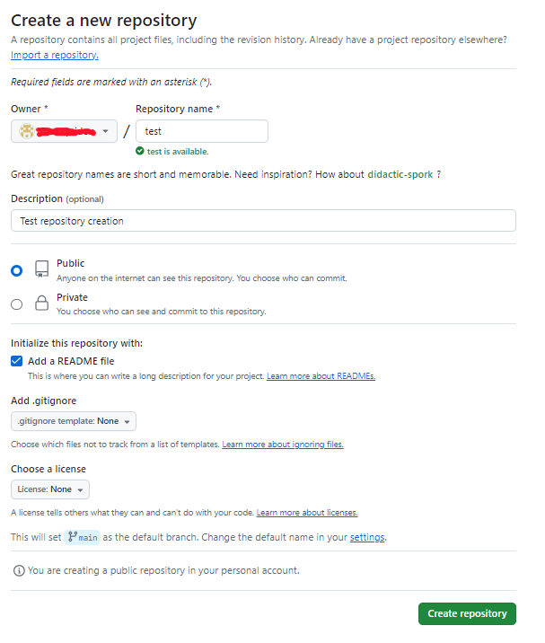
Prepare your environment Create Github Account
Create your Free Github Account using your email
https://github.com/signup
Create your first ‘test’ repository
Create your first public repository with the Github portal and add a README file.
Notes:
Talking Points:
Azure IoT plays a key role in customers digital transformation journey.
We are expanding our IoT Portfolio to support customers evolving needs.
Our existing product portfolio has always been about more than just technology; they are about enabling customer’s possibilities. We're not just connecting devices; we're reimagining how products can redefine user experiences and expand their capabilities. In a world where every second counts, our solutions help customers gain better control and oversight over vast device landscapes, no matter their scale. And it's not just about creating new hardware; it's about crafting gateways for end-users to unlock untapped potential.
But innovation is an ongoing journey that evolves with changing landscape and our customers needs. More and more, we are seeing customers leveraging IoT to not just reimagine their products, but also to transform their physical operations.
For example, an OEM can use IoT data to improve their products or create new business models. As they gain insights from their connected products, they can leverage this data to optimize their physical operations and improve their overall performance. This might involve adding sensors to manufactured goods to offer them as a service and gain deeper insights into how they perform in production.
This is why we’re adding Azure IoT Operations to our IoT portfolio.

Slide 7
Prepare your environment Create Github Account (cont’d)
1. Clone your new repository locally
C:\dev> git clone https://github.com/<YOUR-GITHUB-ALIAS>/test.git
2. Check repository status and branch
C:\dev> cd test C:\dev\test> git status On branch main
Your branch is up to date with 'origin/main'.
nothing to commit, working tree clean
3. Configure your Github configuration
C:\dev\test> git config user.name “<YOUR NAME>” C:\dev\test> git config user.email “<YOUR EMAIL>” C:\dev\test> git config credential.username “<YOUR USER NAME>”
Notes:
Talking Points:
Azure IoT plays a key role in customers digital transformation journey.
We are expanding our IoT Portfolio to support customers evolving needs.
Our existing product portfolio has always been about more than just technology; they are about enabling customer’s possibilities. We're not just connecting devices; we're reimagining how products can redefine user experiences and expand their capabilities. In a world where every second counts, our solutions help customers gain better control and oversight over vast device landscapes, no matter their scale. And it's not just about creating new hardware; it's about crafting gateways for end-users to unlock untapped potential.
But innovation is an ongoing journey that evolves with changing landscape and our customers needs. More and more, we are seeing customers leveraging IoT to not just reimagine their products, but also to transform their physical operations.
For example, an OEM can use IoT data to improve their products or create new business models. As they gain insights from their connected products, they can leverage this data to optimize their physical operations and improve their overall performance. This might involve adding sensors to manufactured goods to offer them as a service and gain deeper insights into how they perform in production.
This is why we’re adding Azure IoT Operations to our IoT portfolio.

Slide 8
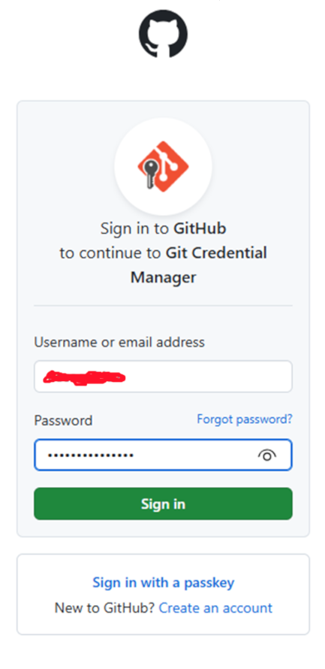
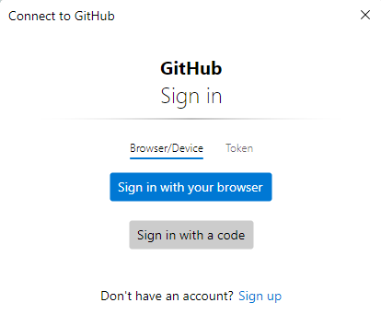
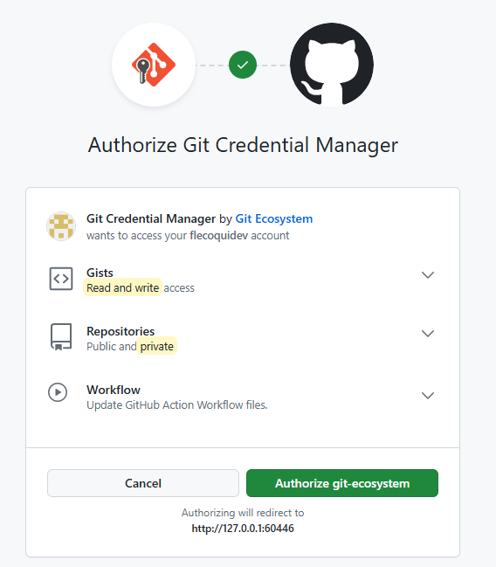
Prepare your environment Create Github Account (cont’d)
4. Update the README.md file and save the update
C:\dev\test> notepad README.md C:\dev\test> git add README.md C:\dev\test> git commit –m “update README.md” C:\dev\test> git push
Notes:
Talking Points:
Azure IoT plays a key role in customers digital transformation journey.
We are expanding our IoT Portfolio to support customers evolving needs.
Our existing product portfolio has always been about more than just technology; they are about enabling customer’s possibilities. We're not just connecting devices; we're reimagining how products can redefine user experiences and expand their capabilities. In a world where every second counts, our solutions help customers gain better control and oversight over vast device landscapes, no matter their scale. And it's not just about creating new hardware; it's about crafting gateways for end-users to unlock untapped potential.
But innovation is an ongoing journey that evolves with changing landscape and our customers needs. More and more, we are seeing customers leveraging IoT to not just reimagine their products, but also to transform their physical operations.
For example, an OEM can use IoT data to improve their products or create new business models. As they gain insights from their connected products, they can leverage this data to optimize their physical operations and improve their overall performance. This might involve adding sensors to manufactured goods to offer them as a service and gain deeper insights into how they perform in production.
This is why we’re adding Azure IoT Operations to our IoT portfolio.

Slide 9
Prepare your environment Create an Azure Free Account
Open the url below to create an Azure Free Account
https://azure.microsoft.com/en-us/free/ Follow the steps to create the Azure Free Account
Notes:
Talking Points:
Azure IoT plays a key role in customers digital transformation journey.
We are expanding our IoT Portfolio to support customers evolving needs.
Our existing product portfolio has always been about more than just technology; they are about enabling customer’s possibilities. We're not just connecting devices; we're reimagining how products can redefine user experiences and expand their capabilities. In a world where every second counts, our solutions help customers gain better control and oversight over vast device landscapes, no matter their scale. And it's not just about creating new hardware; it's about crafting gateways for end-users to unlock untapped potential.
But innovation is an ongoing journey that evolves with changing landscape and our customers needs. More and more, we are seeing customers leveraging IoT to not just reimagine their products, but also to transform their physical operations.
For example, an OEM can use IoT data to improve their products or create new business models. As they gain insights from their connected products, they can leverage this data to optimize their physical operations and improve their overall performance. This might involve adding sensors to manufactured goods to offer them as a service and gain deeper insights into how they perform in production.
This is why we’re adding Azure IoT Operations to our IoT portfolio.

Slide 10
Programming Languages C Overview
Libraries
Libraries
Libraries
Libraries Library code Startup code
Source code files
Binary Executable code (native code)
Libraries
Libraries
Linker
Libraries
object object code
Compiler
Operating System
Notes:
Talking Points:
Azure IoT plays a key role in customers digital transformation journey.
We are expanding our IoT Portfolio to support customers evolving needs.
Our existing product portfolio has always been about more than just technology; they are about enabling customer’s possibilities. We're not just connecting devices; we're reimagining how products can redefine user experiences and expand their capabilities. In a world where every second counts, our solutions help customers gain better control and oversight over vast device landscapes, no matter their scale. And it's not just about creating new hardware; it's about crafting gateways for end-users to unlock untapped potential.
But innovation is an ongoing journey that evolves with changing landscape and our customers needs. More and more, we are seeing customers leveraging IoT to not just reimagine their products, but also to transform their physical operations.
For example, an OEM can use IoT data to improve their products or create new business models. As they gain insights from their connected products, they can leverage this data to optimize their physical operations and improve their overall performance. This might involve adding sensors to manufactured goods to offer them as a service and gain deeper insights into how they perform in production.
This is why we’re adding Azure IoT Operations to our IoT portfolio.

Slide 11
Programming Languages Python Overview
Libraries
Libraries
Libraries
Library Modules
Source code files
Virtual Machine
Libraries
Running Code
Libraries
Libraries
Byte code
Compiler
Operating System
Notes:
Talking Points:
Azure IoT plays a key role in customers digital transformation journey.
We are expanding our IoT Portfolio to support customers evolving needs.
Our existing product portfolio has always been about more than just technology; they are about enabling customer’s possibilities. We're not just connecting devices; we're reimagining how products can redefine user experiences and expand their capabilities. In a world where every second counts, our solutions help customers gain better control and oversight over vast device landscapes, no matter their scale. And it's not just about creating new hardware; it's about crafting gateways for end-users to unlock untapped potential.
But innovation is an ongoing journey that evolves with changing landscape and our customers needs. More and more, we are seeing customers leveraging IoT to not just reimagine their products, but also to transform their physical operations.
For example, an OEM can use IoT data to improve their products or create new business models. As they gain insights from their connected products, they can leverage this data to optimize their physical operations and improve their overall performance. This might involve adding sensors to manufactured goods to offer them as a service and gain deeper insights into how they perform in production.
This is why we’re adding Azure IoT Operations to our IoT portfolio.

Slide 12
Programming Languages Java Overview
Libraries
Libraries
Libraries
Byte Code
Source code files
Java Virtual Machine JVM
Native Code (CPU Instruction)
JIT Compiler (Just-In-Time)
Libraries
Libraries
Libraries
Byte Code
Compiler
Operating System
Notes:
Talking Points:
Azure IoT plays a key role in customers digital transformation journey.
We are expanding our IoT Portfolio to support customers evolving needs.
Our existing product portfolio has always been about more than just technology; they are about enabling customer’s possibilities. We're not just connecting devices; we're reimagining how products can redefine user experiences and expand their capabilities. In a world where every second counts, our solutions help customers gain better control and oversight over vast device landscapes, no matter their scale. And it's not just about creating new hardware; it's about crafting gateways for end-users to unlock untapped potential.
But innovation is an ongoing journey that evolves with changing landscape and our customers needs. More and more, we are seeing customers leveraging IoT to not just reimagine their products, but also to transform their physical operations.
For example, an OEM can use IoT data to improve their products or create new business models. As they gain insights from their connected products, they can leverage this data to optimize their physical operations and improve their overall performance. This might involve adding sensors to manufactured goods to offer them as a service and gain deeper insights into how they perform in production.
This is why we’re adding Azure IoT Operations to our IoT portfolio.

Slide 13
Programming Languages C# Overview
Libraries
Libraries
Libraries
Libraries (IL)
Source code files
Command Language Runtime CLR
Native Code (CPU Instruction)
JIT Compiler (Just-In-Time)
Libraries
Libraries
Libraries
Intermediate Language (IL)
Compiler
Operating System
Notes:
Talking Points:
Azure IoT plays a key role in customers digital transformation journey.
We are expanding our IoT Portfolio to support customers evolving needs.
Our existing product portfolio has always been about more than just technology; they are about enabling customer’s possibilities. We're not just connecting devices; we're reimagining how products can redefine user experiences and expand their capabilities. In a world where every second counts, our solutions help customers gain better control and oversight over vast device landscapes, no matter their scale. And it's not just about creating new hardware; it's about crafting gateways for end-users to unlock untapped potential.
But innovation is an ongoing journey that evolves with changing landscape and our customers needs. More and more, we are seeing customers leveraging IoT to not just reimagine their products, but also to transform their physical operations.
For example, an OEM can use IoT data to improve their products or create new business models. As they gain insights from their connected products, they can leverage this data to optimize their physical operations and improve their overall performance. This might involve adding sensors to manufactured goods to offer them as a service and gain deeper insights into how they perform in production.
This is why we’re adding Azure IoT Operations to our IoT portfolio.

Slide 14
Programming Languages HTML/Javascript Overview
Libraries
Libraries
Libraries
Minifier
Javascript/CSS Libraries
Source code files HTML,JS,CSS
HTTP Server
Minified files HTML, JS, CSS, …
HTTPS
HTTPS
HTTPS
Operating System Client Side
Web Browser
Web Browser
Web Browser
Notes:
Talking Points:
Azure IoT plays a key role in customers digital transformation journey.
We are expanding our IoT Portfolio to support customers evolving needs.
Our existing product portfolio has always been about more than just technology; they are about enabling customer’s possibilities. We're not just connecting devices; we're reimagining how products can redefine user experiences and expand their capabilities. In a world where every second counts, our solutions help customers gain better control and oversight over vast device landscapes, no matter their scale. And it's not just about creating new hardware; it's about crafting gateways for end-users to unlock untapped potential.
But innovation is an ongoing journey that evolves with changing landscape and our customers needs. More and more, we are seeing customers leveraging IoT to not just reimagine their products, but also to transform their physical operations.
For example, an OEM can use IoT data to improve their products or create new business models. As they gain insights from their connected products, they can leverage this data to optimize their physical operations and improve their overall performance. This might involve adding sensors to manufactured goods to offer them as a service and gain deeper insights into how they perform in production.
This is why we’re adding Azure IoT Operations to our IoT portfolio.

Slide 15
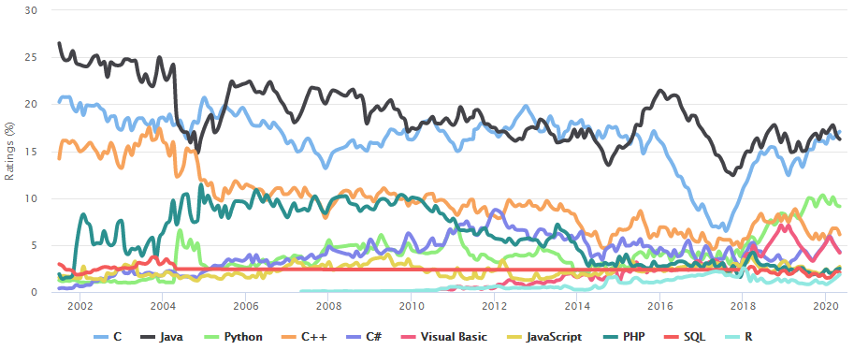
Programming Languages Overview
Notes:
Talking Points:
Azure IoT plays a key role in customers digital transformation journey.
We are expanding our IoT Portfolio to support customers evolving needs.
Our existing product portfolio has always been about more than just technology; they are about enabling customer’s possibilities. We're not just connecting devices; we're reimagining how products can redefine user experiences and expand their capabilities. In a world where every second counts, our solutions help customers gain better control and oversight over vast device landscapes, no matter their scale. And it's not just about creating new hardware; it's about crafting gateways for end-users to unlock untapped potential.
But innovation is an ongoing journey that evolves with changing landscape and our customers needs. More and more, we are seeing customers leveraging IoT to not just reimagine their products, but also to transform their physical operations.
For example, an OEM can use IoT data to improve their products or create new business models. As they gain insights from their connected products, they can leverage this data to optimize their physical operations and improve their overall performance. This might involve adding sensors to manufactured goods to offer them as a service and gain deeper insights into how they perform in production.
This is why we’re adding Azure IoT Operations to our IoT portfolio.

Slide 16
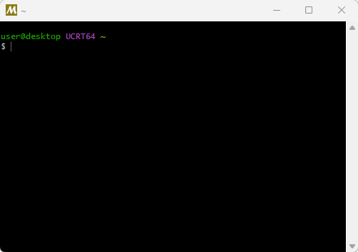
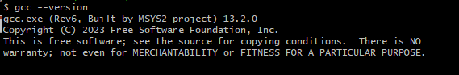
C Language Install the compiler, linker, builder
GCC compiler on Windows
1. We will use the following GCC compiler on Windows https://www.mingw-w64.org/ 2. Install MSYS2 on your machine Information: https://www.msys2.org/ Binaries: https://github.com/msys2/msys2-installer/releases/download/2024-05-07/msys2-x86_64-20240507.exe
3. Install GCC in MSYS2 shell: pacman -S mingw-w64-ucrt-x86_64-gcc 4. Run GCC: gcc –version gcc.exe (Rev6, Built by MSYS2 project) 13.2.0
Copyright (C) 2023 Free Software Foundation, Inc.
This is free software; see the source for copying conditions. There is NO
warranty; not even for MERCHANTABILITY or FITNESS FOR A PARTICULAR PURPOSE.
Notes:
Talking Points:
Azure IoT plays a key role in customers digital transformation journey.
We are expanding our IoT Portfolio to support customers evolving needs.
Our existing product portfolio has always been about more than just technology; they are about enabling customer’s possibilities. We're not just connecting devices; we're reimagining how products can redefine user experiences and expand their capabilities. In a world where every second counts, our solutions help customers gain better control and oversight over vast device landscapes, no matter their scale. And it's not just about creating new hardware; it's about crafting gateways for end-users to unlock untapped potential.
But innovation is an ongoing journey that evolves with changing landscape and our customers needs. More and more, we are seeing customers leveraging IoT to not just reimagine their products, but also to transform their physical operations.
For example, an OEM can use IoT data to improve their products or create new business models. As they gain insights from their connected products, they can leverage this data to optimize their physical operations and improve their overall performance. This might involve adding sensors to manufactured goods to offer them as a service and gain deeper insights into how they perform in production.
This is why we’re adding Azure IoT Operations to our IoT portfolio.

Slide 17
C Language Create your first program
Open MSYS2 shell
Run the following command in the MSYS2 shell
notepad test.c
Add the following lines in the file
#include "stdio.h"
int main()
{
printf("Hello World\n");
}
Compile the source file ‘test.c’
gcc test.c –o test.exe
Run the program in the MSYS2 shell
./test.exe
Run the program in the cmd shell under c:\msys64\home\<YOURNAME>
test.exe
Notes:
Talking Points:
Azure IoT plays a key role in customers digital transformation journey.
We are expanding our IoT Portfolio to support customers evolving needs.
Our existing product portfolio has always been about more than just technology; they are about enabling customer’s possibilities. We're not just connecting devices; we're reimagining how products can redefine user experiences and expand their capabilities. In a world where every second counts, our solutions help customers gain better control and oversight over vast device landscapes, no matter their scale. And it's not just about creating new hardware; it's about crafting gateways for end-users to unlock untapped potential.
But innovation is an ongoing journey that evolves with changing landscape and our customers needs. More and more, we are seeing customers leveraging IoT to not just reimagine their products, but also to transform their physical operations.
For example, an OEM can use IoT data to improve their products or create new business models. As they gain insights from their connected products, they can leverage this data to optimize their physical operations and improve their overall performance. This might involve adding sensors to manufactured goods to offer them as a service and gain deeper insights into how they perform in production.
This is why we’re adding Azure IoT Operations to our IoT portfolio.

Slide 18
C Language Optimize your program size
Compile and build the application and optimize the size
Run the following command in the MSYS2 shell
gcc test.c -o testO.exe -O2 -s
Check the size of the new binary
Run the following command in the MSYS2 shell
ls –l
Compile the source file ‘test.c’
gcc test.c –o test.asm -S
Run the program in the MSYS2 shell
./test.exe
Run the program in the cmd shell under c:\msys64\home\<YOURNAME>
test.exe
Notes:
Talking Points:
Azure IoT plays a key role in customers digital transformation journey.
We are expanding our IoT Portfolio to support customers evolving needs.
Our existing product portfolio has always been about more than just technology; they are about enabling customer’s possibilities. We're not just connecting devices; we're reimagining how products can redefine user experiences and expand their capabilities. In a world where every second counts, our solutions help customers gain better control and oversight over vast device landscapes, no matter their scale. And it's not just about creating new hardware; it's about crafting gateways for end-users to unlock untapped potential.
But innovation is an ongoing journey that evolves with changing landscape and our customers needs. More and more, we are seeing customers leveraging IoT to not just reimagine their products, but also to transform their physical operations.
For example, an OEM can use IoT data to improve their products or create new business models. As they gain insights from their connected products, they can leverage this data to optimize their physical operations and improve their overall performance. This might involve adding sensors to manufactured goods to offer them as a service and gain deeper insights into how they perform in production.
This is why we’re adding Azure IoT Operations to our IoT portfolio.

Slide 19
C Language Create your first program
Open MSYS2 shell
Run the following command in the MSYS2 shell
notepad test.c
Add the following lines in the file
#include "stdio.h"
int main()
{
printf("Hello World\n");
}
Compile the source file ‘test.c’
gcc test.c –o test.exe
Run the program in the MSYS2 shell
./test.exe
Run the program in the cmd shell under c:\msys64\home\<YOURNAME>
test.exe
Notes:
Talking Points:
Azure IoT plays a key role in customers digital transformation journey.
We are expanding our IoT Portfolio to support customers evolving needs.
Our existing product portfolio has always been about more than just technology; they are about enabling customer’s possibilities. We're not just connecting devices; we're reimagining how products can redefine user experiences and expand their capabilities. In a world where every second counts, our solutions help customers gain better control and oversight over vast device landscapes, no matter their scale. And it's not just about creating new hardware; it's about crafting gateways for end-users to unlock untapped potential.
But innovation is an ongoing journey that evolves with changing landscape and our customers needs. More and more, we are seeing customers leveraging IoT to not just reimagine their products, but also to transform their physical operations.
For example, an OEM can use IoT data to improve their products or create new business models. As they gain insights from their connected products, they can leverage this data to optimize their physical operations and improve their overall performance. This might involve adding sensors to manufactured goods to offer them as a service and gain deeper insights into how they perform in production.
This is why we’re adding Azure IoT Operations to our IoT portfolio.

Slide 20
C Language Create your second program
Add the following lines in the file
#include "stdio.h"
int main()
{
char ch;
printf("How is the World? M: Mad, B: Beautiful \n");
ch=fgetc(stdin);
if(ch=='M'){
printf("Hello Mad World!\n");
}
else if(ch=='B'){
printf("Hello Beautiful World!\n");
}
else{
printf("Hello World!\n");
}
}
Notes:
Talking Points:
Azure IoT plays a key role in customers digital transformation journey.
We are expanding our IoT Portfolio to support customers evolving needs.
Our existing product portfolio has always been about more than just technology; they are about enabling customer’s possibilities. We're not just connecting devices; we're reimagining how products can redefine user experiences and expand their capabilities. In a world where every second counts, our solutions help customers gain better control and oversight over vast device landscapes, no matter their scale. And it's not just about creating new hardware; it's about crafting gateways for end-users to unlock untapped potential.
But innovation is an ongoing journey that evolves with changing landscape and our customers needs. More and more, we are seeing customers leveraging IoT to not just reimagine their products, but also to transform their physical operations.
For example, an OEM can use IoT data to improve their products or create new business models. As they gain insights from their connected products, they can leverage this data to optimize their physical operations and improve their overall performance. This might involve adding sensors to manufactured goods to offer them as a service and gain deeper insights into how they perform in production.
This is why we’re adding Azure IoT Operations to our IoT portfolio.

Slide 21
C Language Create your third program
Add the following lines in the file
#include "stdio.h"
int main()
{
char str[3];
char const *sunny = "sunny";
printf("How is the World?\n");
gets(str);
printf("Hello %s and %s World!\n",str,sunny);
}
Notes:
Talking Points:
Azure IoT plays a key role in customers digital transformation journey.
We are expanding our IoT Portfolio to support customers evolving needs.
Our existing product portfolio has always been about more than just technology; they are about enabling customer’s possibilities. We're not just connecting devices; we're reimagining how products can redefine user experiences and expand their capabilities. In a world where every second counts, our solutions help customers gain better control and oversight over vast device landscapes, no matter their scale. And it's not just about creating new hardware; it's about crafting gateways for end-users to unlock untapped potential.
But innovation is an ongoing journey that evolves with changing landscape and our customers needs. More and more, we are seeing customers leveraging IoT to not just reimagine their products, but also to transform their physical operations.
For example, an OEM can use IoT data to improve their products or create new business models. As they gain insights from their connected products, they can leverage this data to optimize their physical operations and improve their overall performance. This might involve adding sensors to manufactured goods to offer them as a service and gain deeper insights into how they perform in production.
This is why we’re adding Azure IoT Operations to our IoT portfolio.

Slide 22
C Language Create your third program
Add the following lines in the file
#include "stdio.h"
int main()
{
char str[3];
char const *sunny = "sunny";
printf("How is the World?\n");
gets(str);
printf("Hello %s and %s World!\n",str,sunny);
}
What will happen if you enter a string with at least 4 characters?
Notes:
Talking Points:
Azure IoT plays a key role in customers digital transformation journey.
We are expanding our IoT Portfolio to support customers evolving needs.
Our existing product portfolio has always been about more than just technology; they are about enabling customer’s possibilities. We're not just connecting devices; we're reimagining how products can redefine user experiences and expand their capabilities. In a world where every second counts, our solutions help customers gain better control and oversight over vast device landscapes, no matter their scale. And it's not just about creating new hardware; it's about crafting gateways for end-users to unlock untapped potential.
But innovation is an ongoing journey that evolves with changing landscape and our customers needs. More and more, we are seeing customers leveraging IoT to not just reimagine their products, but also to transform their physical operations.
For example, an OEM can use IoT data to improve their products or create new business models. As they gain insights from their connected products, they can leverage this data to optimize their physical operations and improve their overall performance. This might involve adding sensors to manufactured goods to offer them as a service and gain deeper insights into how they perform in production.
This is why we’re adding Azure IoT Operations to our IoT portfolio.

Slide 23
C Language Create your fourth program
Add the following lines in the file
#include "stdio.h"
#define MAX_LIMIT 3
int main()
{
char str[MAX_LIMIT];
char const *sunny = "sunny";
printf("How is the World?\n");
fgets(str, MAX_LIMIT, stdin);
printf("Hello %s and %s World!\n",str,sunny);
}
Notes:
Talking Points:
Azure IoT plays a key role in customers digital transformation journey.
We are expanding our IoT Portfolio to support customers evolving needs.
Our existing product portfolio has always been about more than just technology; they are about enabling customer’s possibilities. We're not just connecting devices; we're reimagining how products can redefine user experiences and expand their capabilities. In a world where every second counts, our solutions help customers gain better control and oversight over vast device landscapes, no matter their scale. And it's not just about creating new hardware; it's about crafting gateways for end-users to unlock untapped potential.
But innovation is an ongoing journey that evolves with changing landscape and our customers needs. More and more, we are seeing customers leveraging IoT to not just reimagine their products, but also to transform their physical operations.
For example, an OEM can use IoT data to improve their products or create new business models. As they gain insights from their connected products, they can leverage this data to optimize their physical operations and improve their overall performance. This might involve adding sensors to manufactured goods to offer them as a service and gain deeper insights into how they perform in production.
This is why we’re adding Azure IoT Operations to our IoT portfolio.

Slide 24
C Language Create your fifth program
Add the following lines in the file and test the program on Windows
#include <stdio.h>
#include <conio.h>
int main()
{
printf("The World is running, press escape to exit\n");
while (1) {
if ( kbhit() ) {
int ch;
ch = getch();
if (ch == 0x1B){
printf("ESC key pressed, exit\n");
break;
}
else
printf("Key pressed = '%c'\n",ch);
}
}
return 0;
}
Notes:
Talking Points:
Azure IoT plays a key role in customers digital transformation journey.
We are expanding our IoT Portfolio to support customers evolving needs.
Our existing product portfolio has always been about more than just technology; they are about enabling customer’s possibilities. We're not just connecting devices; we're reimagining how products can redefine user experiences and expand their capabilities. In a world where every second counts, our solutions help customers gain better control and oversight over vast device landscapes, no matter their scale. And it's not just about creating new hardware; it's about crafting gateways for end-users to unlock untapped potential.
But innovation is an ongoing journey that evolves with changing landscape and our customers needs. More and more, we are seeing customers leveraging IoT to not just reimagine their products, but also to transform their physical operations.
For example, an OEM can use IoT data to improve their products or create new business models. As they gain insights from their connected products, they can leverage this data to optimize their physical operations and improve their overall performance. This might involve adding sensors to manufactured goods to offer them as a service and gain deeper insights into how they perform in production.
This is why we’re adding Azure IoT Operations to our IoT portfolio.

Slide 25
C Language Create your sixth program
Add the following lines in the file and test the program on Linux
#include <stdio.h>
#include <stdlib.h>
#include <string.h>
#include <termios.h>
#include <ctype.h>
#include <sys/ioctl.h>
#include <unistd.h>
int kbhit()
{
int byteswaiting;
ioctl(STDIN_FILENO, FIONREAD, &byteswaiting);
return byteswaiting;
}
int getch(void)
{
int ch;
ch = getchar();
return ch;
}
void enable_raw_mode()
{
struct termios term;
tcgetattr(STDIN_FILENO, &term);
term.c_lflag &= ~(ICANON | ECHO); // Disable echo as well
tcsetattr(STDIN_FILENO, TCSANOW, &term);
}
Notes:
Talking Points:
Azure IoT plays a key role in customers digital transformation journey.
We are expanding our IoT Portfolio to support customers evolving needs.
Our existing product portfolio has always been about more than just technology; they are about enabling customer’s possibilities. We're not just connecting devices; we're reimagining how products can redefine user experiences and expand their capabilities. In a world where every second counts, our solutions help customers gain better control and oversight over vast device landscapes, no matter their scale. And it's not just about creating new hardware; it's about crafting gateways for end-users to unlock untapped potential.
But innovation is an ongoing journey that evolves with changing landscape and our customers needs. More and more, we are seeing customers leveraging IoT to not just reimagine their products, but also to transform their physical operations.
For example, an OEM can use IoT data to improve their products or create new business models. As they gain insights from their connected products, they can leverage this data to optimize their physical operations and improve their overall performance. This might involve adding sensors to manufactured goods to offer them as a service and gain deeper insights into how they perform in production.
This is why we’re adding Azure IoT Operations to our IoT portfolio.

Slide 26
C Language Create your sixth program (cont’d)
void disable_raw_mode()
{
struct termios term;
tcgetattr(STDIN_FILENO, &term);
term.c_lflag |= ICANON | ECHO;
tcsetattr(STDIN_FILENO, TCSANOW, &term);
}
int main()
{
char ch;
printf("The World is running, press escape to exit\n");
enable_raw_mode();
while (1) {
if ( kbhit() ) {
ch = getch();
if (ch == 0x1B){
printf("ESC key pressed, exit\n");
break;
}
else
printf("Key pressed = '%c'\n",ch);
}
}
disable_raw_mode();
return 0;
}
Notes:
Talking Points:
Azure IoT plays a key role in customers digital transformation journey.
We are expanding our IoT Portfolio to support customers evolving needs.
Our existing product portfolio has always been about more than just technology; they are about enabling customer’s possibilities. We're not just connecting devices; we're reimagining how products can redefine user experiences and expand their capabilities. In a world where every second counts, our solutions help customers gain better control and oversight over vast device landscapes, no matter their scale. And it's not just about creating new hardware; it's about crafting gateways for end-users to unlock untapped potential.
But innovation is an ongoing journey that evolves with changing landscape and our customers needs. More and more, we are seeing customers leveraging IoT to not just reimagine their products, but also to transform their physical operations.
For example, an OEM can use IoT data to improve their products or create new business models. As they gain insights from their connected products, they can leverage this data to optimize their physical operations and improve their overall performance. This might involve adding sensors to manufactured goods to offer them as a service and gain deeper insights into how they perform in production.
This is why we’re adding Azure IoT Operations to our IoT portfolio.

Slide 27
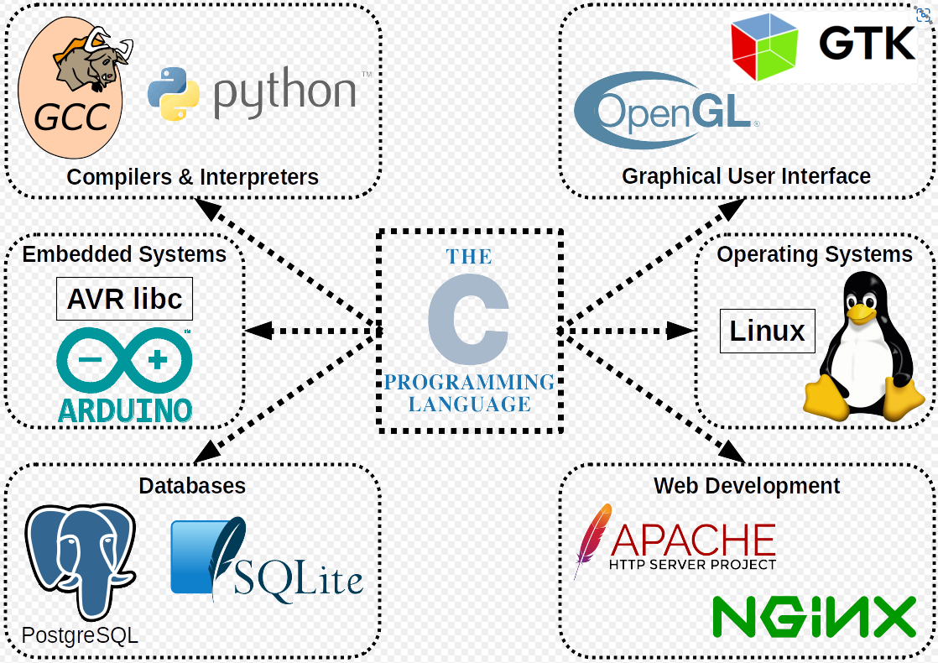
C Language Resources
C Programming Language
C Programming Language https://en.wikipedia.org/wiki/C_(programming_language)
C Programming Language The Book: https://en.wikipedia.org/wiki/The_C_Programming_Language
VLC Source code : https://code.videolan.org/videolan/vlc
Notes:
Talking Points:
Azure IoT plays a key role in customers digital transformation journey.
We are expanding our IoT Portfolio to support customers evolving needs.
Our existing product portfolio has always been about more than just technology; they are about enabling customer’s possibilities. We're not just connecting devices; we're reimagining how products can redefine user experiences and expand their capabilities. In a world where every second counts, our solutions help customers gain better control and oversight over vast device landscapes, no matter their scale. And it's not just about creating new hardware; it's about crafting gateways for end-users to unlock untapped potential.
But innovation is an ongoing journey that evolves with changing landscape and our customers needs. More and more, we are seeing customers leveraging IoT to not just reimagine their products, but also to transform their physical operations.
For example, an OEM can use IoT data to improve their products or create new business models. As they gain insights from their connected products, they can leverage this data to optimize their physical operations and improve their overall performance. This might involve adding sensors to manufactured goods to offer them as a service and gain deeper insights into how they perform in production.
This is why we’re adding Azure IoT Operations to our IoT portfolio.

Slide 28
Python Language Install the compiler, linker, builder
GCC compiler on Windows
1. We will use the following GCC compiler on Windows https://www.mingw-w64.org/ 2. Install MSYS2 on your machine Information: https://www.msys2.org/ Binaries: https://github.com/msys2/msys2-installer/releases/download/2024-05-07/msys2-x86_64-20240507.exe
3. Install GCC in MSYS2 shell: pacman -S mingw-w64-ucrt-x86_64-gcc 4. Run GCC: gcc –version gcc.exe (Rev6, Built by MSYS2 project) 13.2.0
Copyright (C) 2023 Free Software Foundation, Inc.
This is free software; see the source for copying conditions. There is NO
warranty; not even for MERCHANTABILITY or FITNESS FOR A PARTICULAR PURPOSE.
Notes:
Talking Points:
Azure IoT plays a key role in customers digital transformation journey.
We are expanding our IoT Portfolio to support customers evolving needs.
Our existing product portfolio has always been about more than just technology; they are about enabling customer’s possibilities. We're not just connecting devices; we're reimagining how products can redefine user experiences and expand their capabilities. In a world where every second counts, our solutions help customers gain better control and oversight over vast device landscapes, no matter their scale. And it's not just about creating new hardware; it's about crafting gateways for end-users to unlock untapped potential.
But innovation is an ongoing journey that evolves with changing landscape and our customers needs. More and more, we are seeing customers leveraging IoT to not just reimagine their products, but also to transform their physical operations.
For example, an OEM can use IoT data to improve their products or create new business models. As they gain insights from their connected products, they can leverage this data to optimize their physical operations and improve their overall performance. This might involve adding sensors to manufactured goods to offer them as a service and gain deeper insights into how they perform in production.
This is why we’re adding Azure IoT Operations to our IoT portfolio.

Slide 29
Java Language Install the compiler, linker, builder
Java compiler on Windows
1. We will https://www.oracle.com/java/technologies/downloads/#java17 Devcontainer Java 21 2. Install MSYS2 on your machine Information: https://www.msys2.org/ Binaries: https://github.com/msys2/msys2-installer/releases/download/2024-05-07/msys2-x86_64-20240507.exe
3. Install GCC in MSYS2 shell: pacman -S mingw-w64-ucrt-x86_64-gcc 4. Run GCC: gcc –version gcc.exe (Rev6, Built by MSYS2 project) 13.2.0
Copyright (C) 2023 Free Software Foundation, Inc.
This is free software; see the source for copying conditions. There is NO
warranty; not even for MERCHANTABILITY or FITNESS FOR A PARTICULAR PURPOSE.
Notes:
Talking Points:
Azure IoT plays a key role in customers digital transformation journey.
We are expanding our IoT Portfolio to support customers evolving needs.
Our existing product portfolio has always been about more than just technology; they are about enabling customer’s possibilities. We're not just connecting devices; we're reimagining how products can redefine user experiences and expand their capabilities. In a world where every second counts, our solutions help customers gain better control and oversight over vast device landscapes, no matter their scale. And it's not just about creating new hardware; it's about crafting gateways for end-users to unlock untapped potential.
But innovation is an ongoing journey that evolves with changing landscape and our customers needs. More and more, we are seeing customers leveraging IoT to not just reimagine their products, but also to transform their physical operations.
For example, an OEM can use IoT data to improve their products or create new business models. As they gain insights from their connected products, they can leverage this data to optimize their physical operations and improve their overall performance. This might involve adding sensors to manufactured goods to offer them as a service and gain deeper insights into how they perform in production.
This is why we’re adding Azure IoT Operations to our IoT portfolio.

Slide 30

Resources
Product 1: https://www.aka.ms/AzureIoTOperations
Product Documentation: https://aka.ms/LearnAzureIoTOperations
Azure For Manufacturing: http://aka.ms/AzureForManufacturing
Arc Jumpstart: http://aka.ms/AzureArcJumpstart
And more to come …
Notes:
Talking Points:
Finally, we have several resources to learn more about Azure IoT Operations and Azure for Manufacturing that are listed here on this slide.

